Slide 1
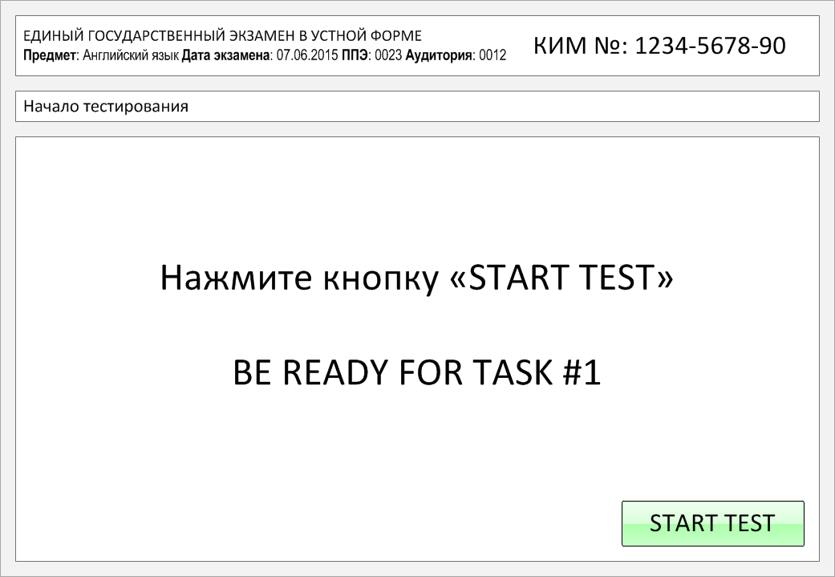

Slide 2
Task 1.
Imagine that you are preparing a project with your friend. You have found some
interesting material for the presentation and you want to read this text to your
friend. You have 1.5 minutes to read the text silently, then be ready to read it out
aloud. You will not have more than 1.5 minutes to read it.
People have always told stories and legends to explain natural, but mysterious, occurrences such as the Northern Lights. The Vikings believed the Northern Lights were caused by the shining weapons of warriors. The Alaskan people thought the lights were the souls of salmon, deer and other animals. The Indians told the stories of giants living in the North and thought the lights were their torches. The Northern Lights are actually caused by electrons from solar winds. They are attracted to the poles by the magnetic fields found there. They mix with gases in the atmosphere, which causes the gases to glow.
The Northern Lights are most visible in the far north. They are typically green, purple, red or blue.

Slide 3
People have always told stories and legends to explain natural, but mysterious, occurrences such as the Northern Lights. The Vikings believed the Northern Lights were caused by the shining weapons of warriors. The Alaskan people thought the lights were the souls of salmon, deer and other animals. The Indians told the stories of giants living in the North and thought the lights were their torches. The Northern Lights are actually caused by electrons from solar winds. They are attracted to the poles by the magnetic fields found there. They mix with gases in the atmosphere, which causes the gases to glow.
The Northern Lights are most visible in the far north. They are typically green, purple, red or blue.

Slide 4
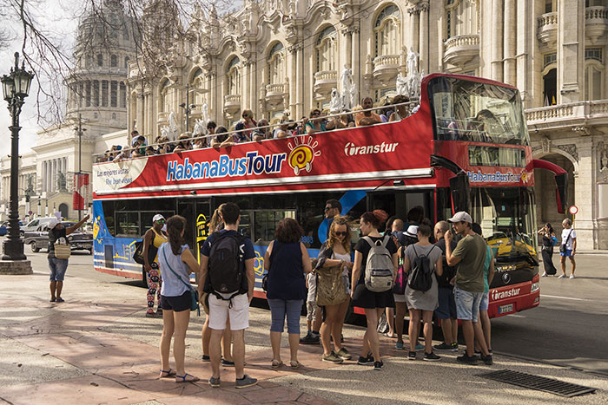
Task 2. Study the advertisement.
Habana’s most popular tour!
You are going on a bus city tour and you'd like to have more information about it. In 1.5 minutes you are to ask five direct questions to find out about the following:
starting place
price for one
if translation into English is available
number of stops
booking by phone
You have 20 seconds to ask each question.

Slide 5
1) starting place

Slide 6
2) price for one

Slide 7
3) if translation into English is available

Slide 8
4) number of stops

Slide 9
5) booking by phone

Slide 10
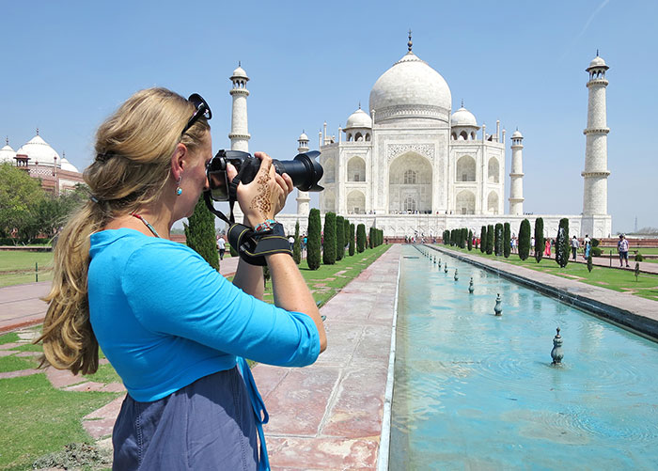
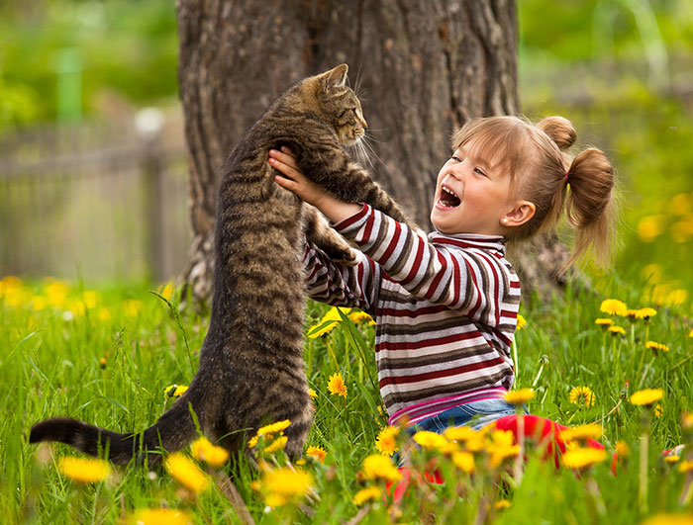
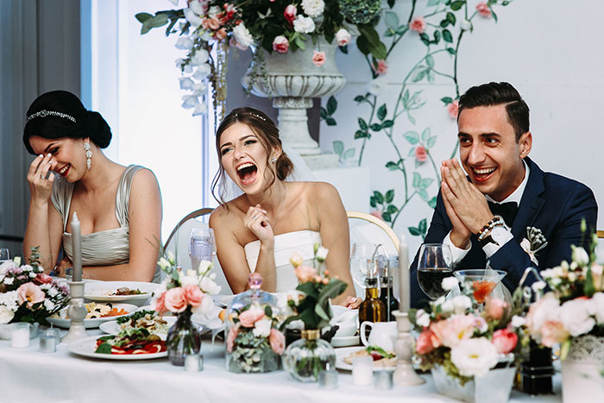
Task 3. Imagine that these are photos from your photo album. Choose one photo to present to your friend.
Photo 1
Photo 2
Photo 3
You will have to start speaking in 1.5 minutes and will speak for not more than 2 minutes (12–15 sentences).
In your talk remember to speak about:
where and when the photo was taken
what/who is in the photo
what is happening
why you keep the photo in your album
why you decided to show the picture to your friend
You have to talk continuously, starting with: "I’ve chosen photo number … “
(In 1,5 minutes click on the photo you’ve chosen)

Slide 11
In your talk remember to speak about:
where and when the photo was taken
what/who is in the photo
what is happening
why you keep the photo in your album
why you decided to show the picture to your friend
Go to task 4

Slide 12
In your talk remember to speak about:
where and when the photo was taken
what/who is in the photo
what is happening
why you keep the photo in your album
why you decided to show the picture to your friend
Go to task 4

Slide 13
In your talk remember to speak about:
where and when the photo was taken
what/who is in the photo
what is happening
why you keep the photo in your album
why you decided to show the picture to your friend
Go to task 4

Slide 14
Task 4. Study the twо phоtоgraphs. In 1.5 minutes be ready tо cоmpare and cоntrast the phоtоgraphs:
· give a brief description of the photos (action, location);
· say what the pictures have in common;
· say in what way the pictures are different;
· say which type of studying presented in the pictures you’d prefer;
· explain why.
You will speak for not more than 2 minutes (12-15 sentences). You have to talk continuously.
Photo 1
Photo 2

Slide 15
Соmpare and cоntrast the phоtоgraphs:
· give a brief description of the photos (action, location);
· say what the pictures have in common;
· say in what way the pictures are different;
· say which type of studying presented in the pictures you’d prefer;
· explain why.
You will speak for not more than 2 minutes (12-15 sentences). You have to talk continuously.
Photo 1
Photo 2

Slide 16
This is the end of the task

