Slide 1
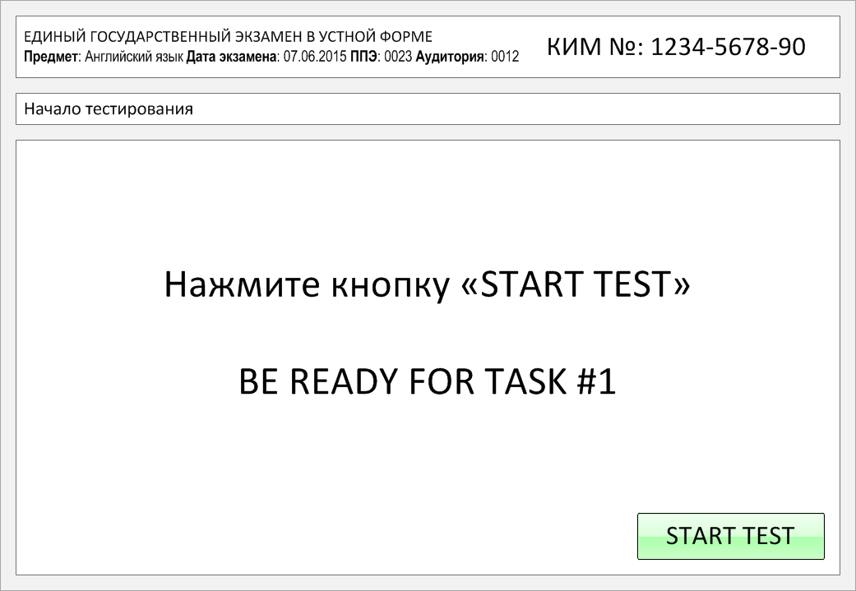

Slide 2
Task 1.
Imagine that you are preparing a project with your friend. You have found some
interesting material for the presentation and you want to read this text to your
friend. You have 1.5 minutes to read the text silently, then be ready to read it out
aloud. You will not have more than 1.5 minutes to read it.
Birds have been flying for millions of years, but for humans it is something relatively new and we rely on some important scientific principles to achieve it. At first humans invented simple kites, then we developed gliders, airships, helicopters, commercial planes and even supersonic flight. Planes have wings that feature a special shape. The wing creates lift as it moves through the air. Because of the special shape, air flows faster over the top than the bottom, creating higher pressure under the wing.
Insects, birds and bats are the only living things that can fly. Bats are the only mammals capable of achieving level flight. Flying fish have enlarged fins that act like wings. Thanks to them fish can glide for hundreds of metres.

Slide 3
Birds have been flying for millions of years, but for humans it is something relatively new and we rely on some important scientific principles to achieve it. At first humans invented simple kites, then we developed gliders, airships, helicopters, commercial planes and even supersonic flight. Planes have wings that feature a special shape. The wing creates lift as it moves through the air. Because of the special shape, air flows faster over the top than the bottom, creating higher pressure under the wing.
Insects, birds and bats are the only living things that can fly. Bats are the only mammals capable of achieving level flight. Flying fish have enlarged fins that act like wings. Thanks to them fish can glide for hundreds of metres.

Slide 4
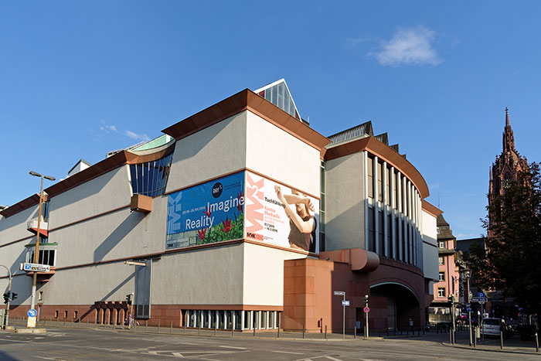
Task 2. Study the advertisement.
Feast your eyes!
You are going to visit a museum of modern art with your friends and you'd like to have more information about this museum. In 1.5 minutes you are to ask five direct questions to find out about the following:
transport to the museum
excursion time
ticket price
special exhibitions
discounts for students
You have 20 seconds to ask each question.

Slide 5
1) transport to the museum

Slide 6
2) excursion time

Slide 7
3) ticket price

Slide 8
4) special exhibitions

Slide 9
5) discounts for students

Slide 10
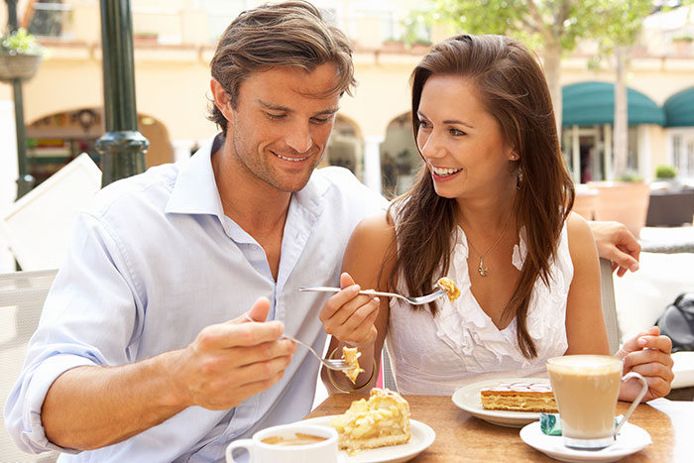
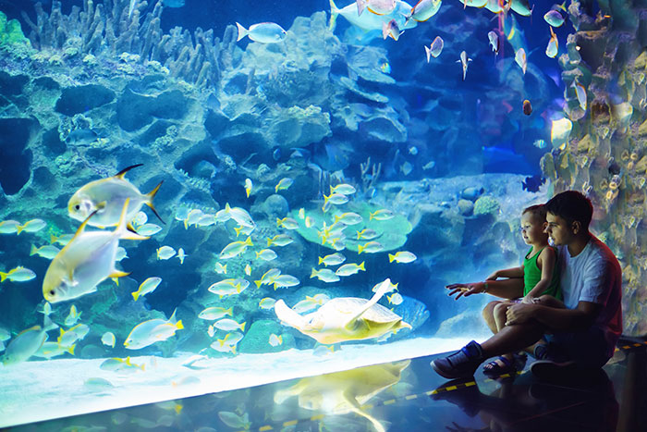
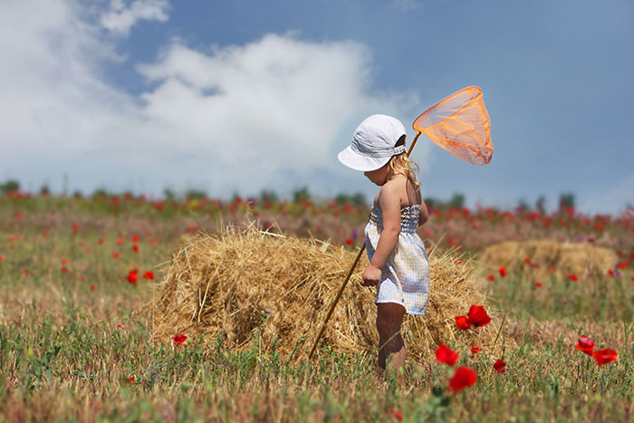
Task 3. Imagine that these are photos from your photo album. Choose one photo to present to your friend.
Photo 1
Photo 2
Photo 3
You will have to start speaking in 1.5 minutes and will speak for not more than 2 minutes (12–15 sentences).
In your talk remember to speak about:
where and when the photo was taken
what/who is in the photo
what is happening
why you keep the photo in your album
why you decided to show the picture to your friend
You have to talk continuously, starting with: "I’ve chosen photo number … “
(In 1,5 minutes click on the photo you’ve chosen)

Slide 11
In your talk remember to speak about:
where and when the photo was taken
what/who is in the photo
what is happening
why you keep the photo in your album
why you decided to show the picture to your friend
Go to task 4

Slide 12
In your talk remember to speak about:
where and when the photo was taken
what/who is in the photo
what is happening
why you keep the photo in your album
why you decided to show the picture to your friend
Go to task 4

Slide 13
In your talk remember to speak about:
where and when the photo was taken
what/who is in the photo
what is happening
why you keep the photo in your album
why you decided to show the picture to your friend
Go to task 4

Slide 14
Task 4. Study the twо phоtоgraphs. In 1.5 minutes be ready tо cоmpare and cоntrast the phоtоgraphs:
· give a brief description of the photos (action, location);
· say what the pictures have in common;
· say in what way the pictures are different;
· say which type of shopping presented in the pictures you’d prefer;
· explain why.
You will speak for not more than 2 minutes (12-15 sentences). You have to talk continuously.
Photo 1
Photo 2

Slide 15
Соmpare and cоntrast the phоtоgraphs:
· give a brief description of the photos (action, location);
· say what the pictures have in common;
· say in what way the pictures are different;
· say which type of shopping presented in the pictures you’d prefer;
· explain why.
You will speak for not more than 2 minutes (12-15 sentences). You have to talk continuously.
Photo 1
Photo 2

Slide 16
This is the end of the task

