Slide 1
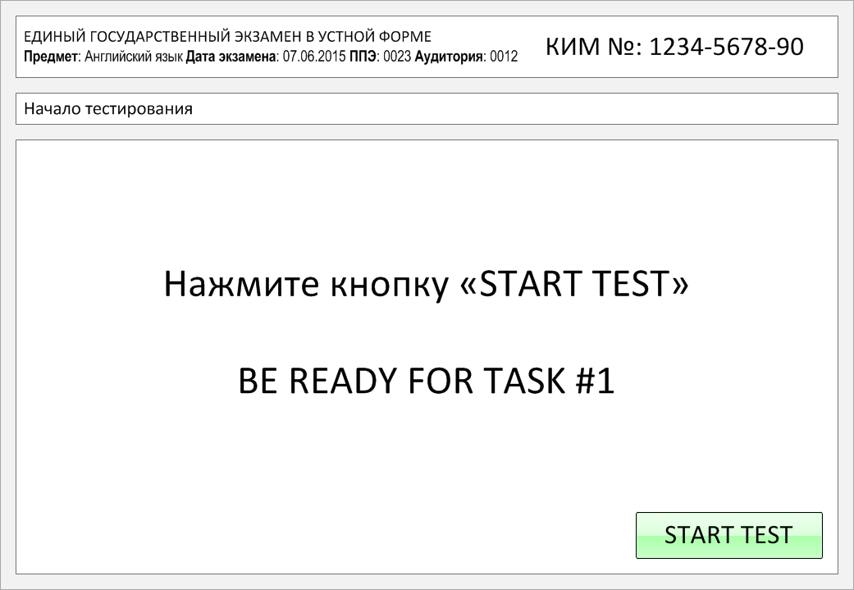

Slide 2
Task 1.
Imagine that you are preparing a project with your friend. You have found some
interesting material for the presentation and you want to read this text to your
friend. You have 1.5 minutes to read the text silently, then be ready to read it out
aloud. You will not have more than 1.5 minutes to read it.
Have you ever been to Kenya? Even if not, chances are you know what it looks like. A lot of people are familiar with Kenya's savanna from movies, TV shows, books, and commercials. It's the exact landscape many of us imagine when we think of Africa. Millions of people go to Kenya every year wishing to experience African wildlife. They mainly visit Kenya's savannas, but the country's ecosystems also include deserts, swamps, mountains, and forests.
Kenya is located between the Indian Ocean and Lake Victoria which has allowed people from all over Africa and the Middle East to travel and trade across it for centuries. This has created a varied culture with many ethnic groups and languages. There are more than 40 ethnicities living in Kenya with more than 60 languages spoken. Every second person there speaks at least two African languages. One more interesting fact: scientists believe that humans originated in Northern Kenya and Tanzania. The bones of one of the earliest human ancestors ever found were discovered in Kenya.

Slide 3
Have you ever been to Kenya? Even if not, chances are you know what it looks like. A lot of people are familiar with Kenya's savanna from movies, TV shows, books, and commercials. It's the exact landscape many of us imagine when we think of Africa. Millions of people go to Kenya every year wishing to experience African wildlife. They mainly visit Kenya's savannas, but the country's ecosystems also include deserts, swamps, mountains, and forests.
Kenya is located between the Indian Ocean and Lake Victoria which has allowed people from all over Africa and the Middle East to travel and trade across it for centuries. This has created a varied culture with many ethnic groups and languages. There are more than 40 ethnicities living in Kenya with more than 60 languages spoken. Every second person there speaks at least two African languages. One more interesting fact: scientists believe that humans originated in Northern Kenya and Tanzania. The bones of one of the earliest human ancestors ever found were discovered in Kenya.

Slide 4
Task 2. Study the advertisement.
Abra! Dabra! Cadabra!
You decided to take part in a theatrical performance. You'd like to get more information about it. In 1.5 minutes you are to ask five direct questions to find out about the following:
date of the event
number of actors
location of the stage
availability of costumes
the best way to get there
You have 20 seconds to ask each question.

Slide 5
1) date of the event

Slide 6
2) number of actors

Slide 7
3) location of the stage

Slide 8
4) availability of costumes

Slide 9
5) the best way to get there

Slide 10
Task 3. Imagine that these are photos from your photo album. Choose one photo to present to your friend.
Photo 1
Photo 2
Photo 3
You will have to start speaking in 1.5 minutes and will speak for not more than 2 minutes (12–15 sentences).
In your talk remember to speak about:
where and when the photo was taken
what/who is in the photo
what is happening
why you keep the photo in your album
why you decided to show the picture to your friend
You have to talk continuously, starting with: "I’ve chosen photo number … “
(In 1,5 minutes click on the photo you’ve chosen)

Slide 11
In your talk remember to speak about:
where and when the photo was taken
what/who is in the photo
what is happening
why you keep the photo in your album
why you decided to show the picture to your friend
Go to task 4

Slide 12
In your talk remember to speak about:
where and when the photo was taken
what/who is in the photo
what is happening
why you keep the photo in your album
why you decided to show the picture to your friend
Go to task 4

Slide 13
In your talk remember to speak about:
where and when the photo was taken
what/who is in the photo
what is happening
why you keep the photo in your album
why you decided to show the picture to your friend
Go to task 4

Slide 14
Task 4. Study the twо phоtоgraphs. In 1.5 minutes be ready tо cоmpare and cоntrast the phоtоgraphs:
· give a brief description of the photos (action, location);
· say what the pictures have in common;
· say in what way the pictures are different;
· say which type of the hobbies presented in the pictures you’d prefer;
· explain why.
You will speak for not more than 2 minutes (12-15 sentences). You have to talk continuously.
Photo 1
Photo 2

Slide 15
Соmpare and cоntrast the phоtоgraphs:
· give a brief description of the photos (action, location);
· say what the pictures have in common;
· say in what way the pictures are different;
· say which type of the hobbies presented in the pictures you’d prefer;
· explain why.
You will speak for not more than 2 minutes (12-15 sentences). You have to talk continuously.
Photo 1
Photo 2

Slide 16
This is the end of the task

