Slide 1
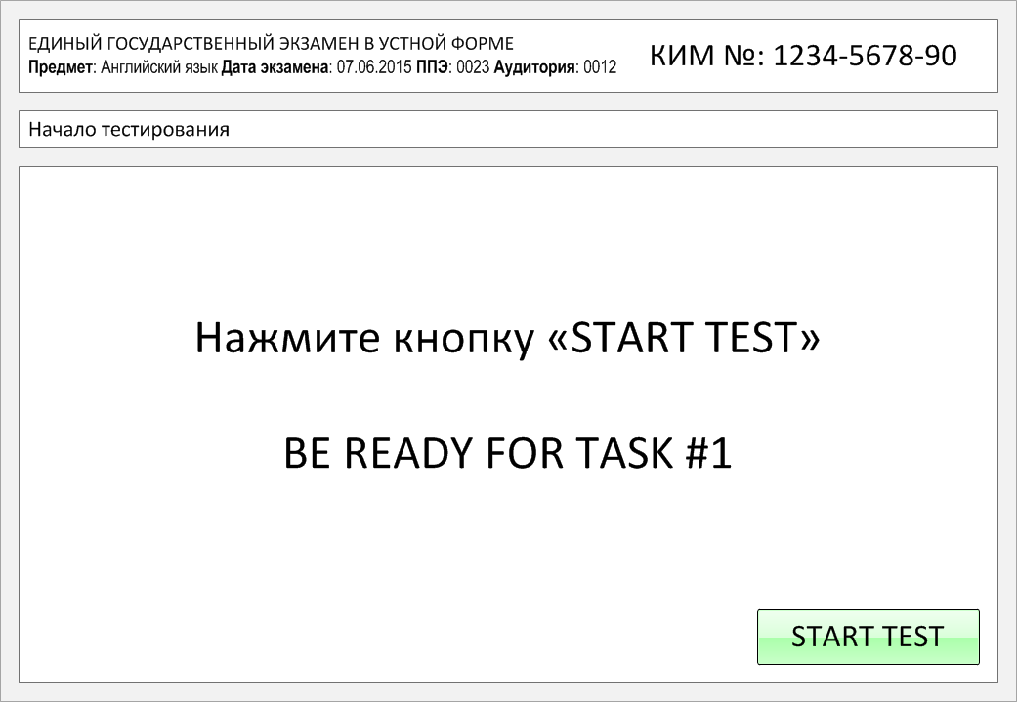

Slide 2
Task 1.
Imagine that you are preparing a project with your friend. You have found some
interesting material for the presentation and you want to read this text to your
friend. You have 1.5 minutes to read the text silently, then be ready to read it out
aloud. You will not have more than 1.5 minutes to read it.
In fact, the term "planet" has not been scientifically defined before the latest discoveries. When the Greeks observed the sky thousands of years ago, they found some objects that acted differently than stars. These points of light seemed to move aimlessly, or wander around, the sky all year long. So, the term "planet" originally derives from the Greek word which means 'a wanderer'.
Before the invention of a telescope, scientists relied on their naked eye and careful observations to explore and classify objects of the night sky. The five closest planets, which are easily visible to us, have been observed throughout the human history.
In the seventeenth century scientists began to use telescopes to explore our solar system. As technology improved, scientists discovered three more planets revolving around the Sun.

Slide 3
In fact, the term "planet" has not been scientifically defined before the latest discoveries. When the Greeks observed the sky thousands of years ago, they found some objects that acted differently than stars. These points of light seemed to move aimlessly, or wander around, the sky all year long. So, the term "planet" originally derives from the Greek word which means 'a wanderer'.
Before the invention of a telescope, scientists relied on their naked eye and careful observations to explore and classify objects of the night sky. The five closest planets, which are easily visible to us, have been observed throughout the human history.
In the seventeenth century scientists began to use telescopes to explore our solar system. As technology improved, scientists discovered three more planets revolving around the Sun.

Slide 4
Task 2. Study the advertisement.
Want to get fit? Play tennis!
You are going to join a tennis club with your friends and you'd like to get more information about this club. In 1.5 minutes you are to ask five direct questions to find out about the following:
location of the tennis club
opening hours
instructor's help
membership fee
discounts for students
You have 20 seconds to ask each question.

Slide 5
1) location of the tennis club

Slide 6
2) opening hours

Slide 7
3) instructor's help

Slide 8
4) membership fee

Slide 9
5) discounts for students

Slide 10
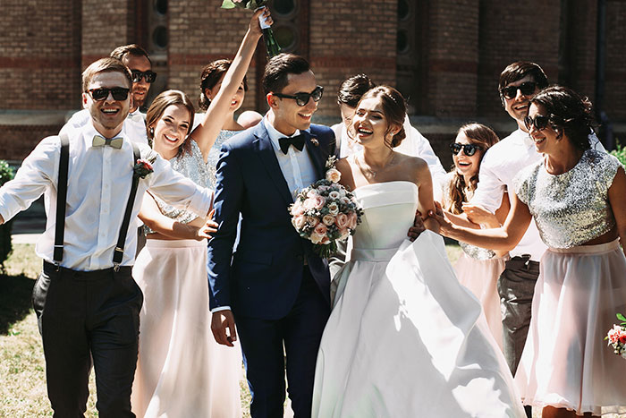
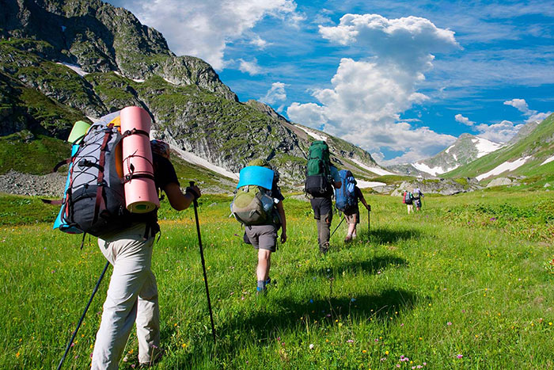
Task 3. Imagine that these are photos from your photo album. Choose one photo to present to your friend.
Photo 1
Photo 2
Photo 3
You will have to start speaking in 1.5 minutes and will speak for not more than 2 minutes (12–15 sentences).
In your talk remember to speak about:
where and when the photo was taken
what/who is in the photo
what is happening
why you keep the photo in your album
why you decided to show the picture to your friend
You have to talk continuously, starting with: "I’ve chosen photo number … “
(In 1,5 minutes click on the photo you’ve chosen)

Slide 11
In your talk remember to speak about:
where and when the photo was taken
what/who is in the photo
what is happening
why you keep the photo in your album
why you decided to show the picture to your friend
Go to task 4

Slide 12
In your talk remember to speak about:
where and when the photo was taken
what/who is in the photo
what is happening
why you keep the photo in your album
why you decided to show the picture to your friend
Go to task 4

Slide 13
In your talk remember to speak about:
where and when the photo was taken
what/who is in the photo
what is happening
why you keep the photo in your album
why you decided to show the picture to your friend
Go to task 4

Slide 14
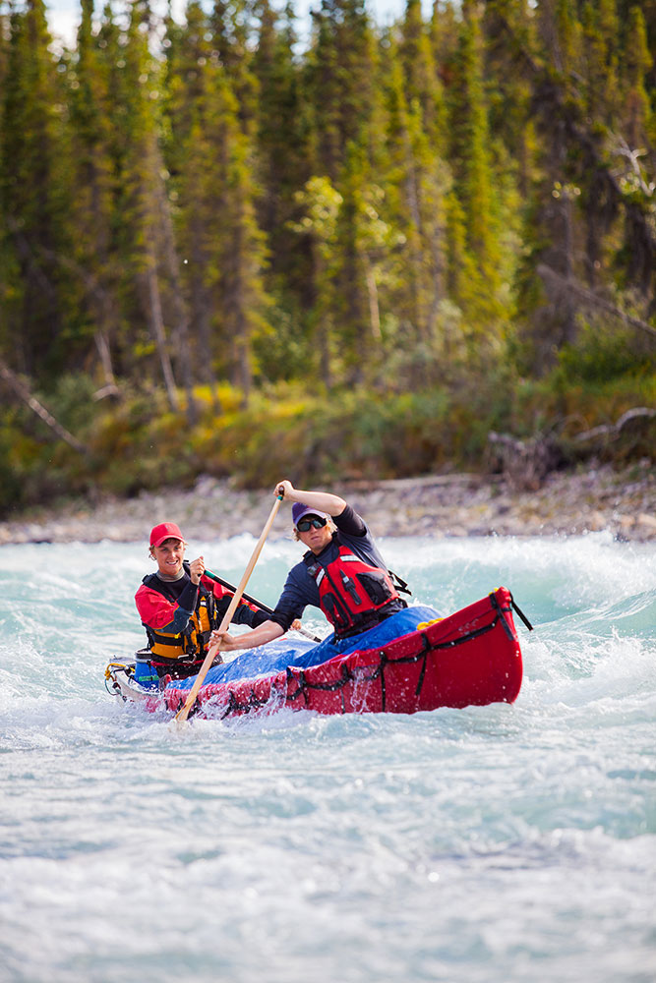
Task 4. Study the twо phоtоgraphs. In 1.5 minutes be ready tо cоmpare and cоntrast the phоtоgraphs:
· give a brief description of the photos (action, location);
· say what the pictures have in common;
· say in what way the pictures are different;
· say which type of holiday presented in the pictures you’d prefer;
· explain why.
You will speak for not more than 2 minutes (12-15 sentences). You have to talk continuously.
Photo 1
Photo 2

Slide 15
Соmpare and cоntrast the phоtоgraphs:
· give a brief description of the photos (action, location);
· say what the pictures have in common;
· say in what way the pictures are different;
· say which type of holiday presented in the pictures you’d prefer;
· explain why.
You will speak for not more than 2 minutes (12-15 sentences). You have to talk continuously.
Photo 1
Photo 2

Slide 16
This is the end of the task

