Slide 1
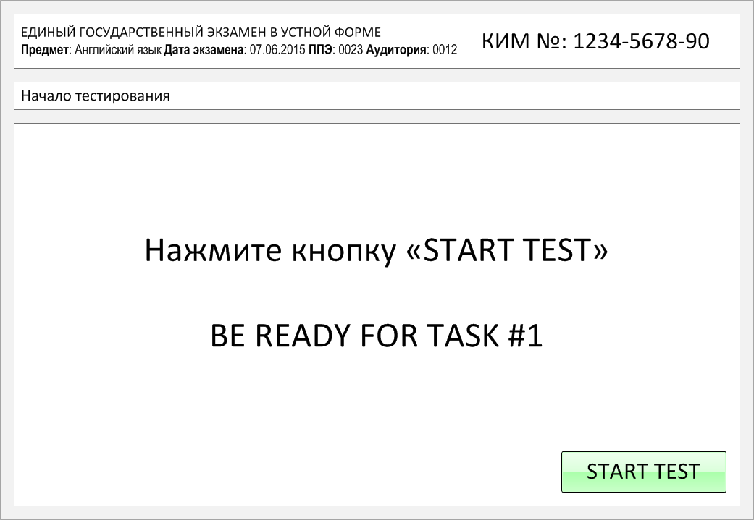

Slide 2
Task 1.
Imagine that you are preparing a project with your friend. You have found some
interesting material for the presentation and you want to read this text to your
friend. You have 1.5 minutes to read the text silently, then be ready to read it out
aloud. You will not have more than 1.5 minutes to read it.
People as well as animals and other living creatures need air to breathe all the time. Oxygen is very important for us. However, it can be a big surprise for us to learn that there is no clear boundary between the Earth's atmosphere and outer space. While we typically think of the Earth as this perfect sphere, scientists have already proved for sure that it is more like a squashed ball. The farther we get away from the ground, the thinner the atmosphere becomes. The atmosphere slowly becomes thinner and thinner until it fades into outer space. There is no clear line or sign that says something like "Welcome to outer space!"
The atmosphere of Earth is one of the unique features that allows such an amazing variety of life forms to exist on the planet. The atmosphere protects us and the other forms of life on Earth from some of the most harmful energy that's produced by the Sun.

Slide 3
People as well as animals and other living creatures need air to breathe all the time. Oxygen is very important for us. However, it can be a big surprise for us to learn that there is no clear boundary between the Earth's atmosphere and outer space. While we typically think of the Earth as this perfect sphere, scientists have already proved for sure that it is more like a squashed ball. The farther we get away from the ground, the thinner the atmosphere becomes. The atmosphere slowly becomes thinner and thinner until it fades into outer space. There is no clear line or sign that says something like "Welcome to outer space!"
The atmosphere of Earth is one of the unique features that allows such an amazing variety of life forms to exist on the planet. The atmosphere protects us and the other forms of life on Earth from some of the most harmful energy that's produced by the Sun.

Slide 4
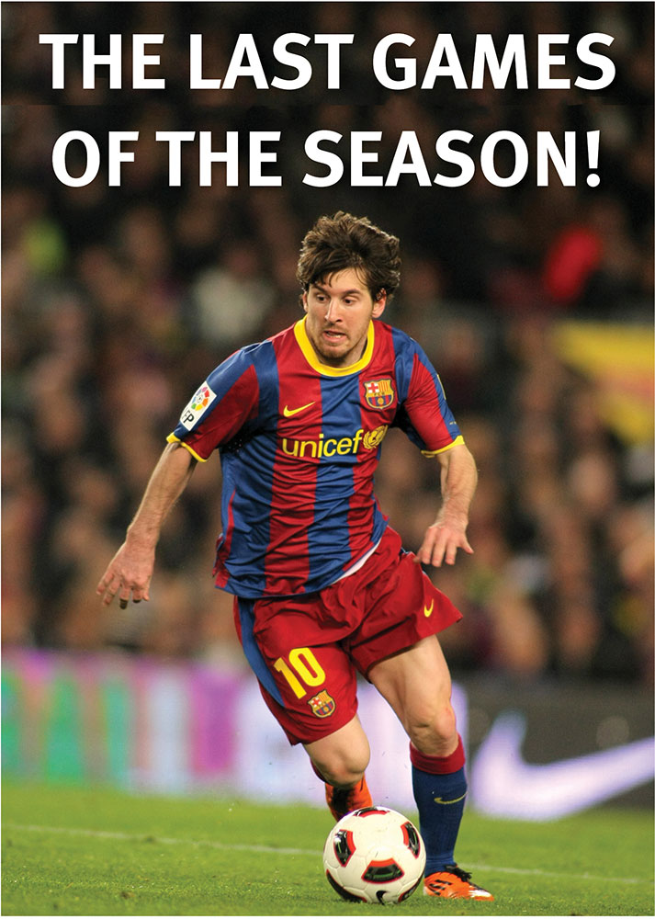
Task 2. Study the advertisement.
You are considering going to see the game and now you'd like to get more information. In 1.5 minutes you are to ask five direct questions to find out about the following:
stadium location
length of the match
ticket price
teams playing
if one can buy snacks there
You have 20 seconds to ask each question.

Slide 5
1) stadium location

Slide 6
2) length of the match

Slide 7
3) ticket price

Slide 8
4) teams playing

Slide 9
5) if one can buy snacks there

Slide 10
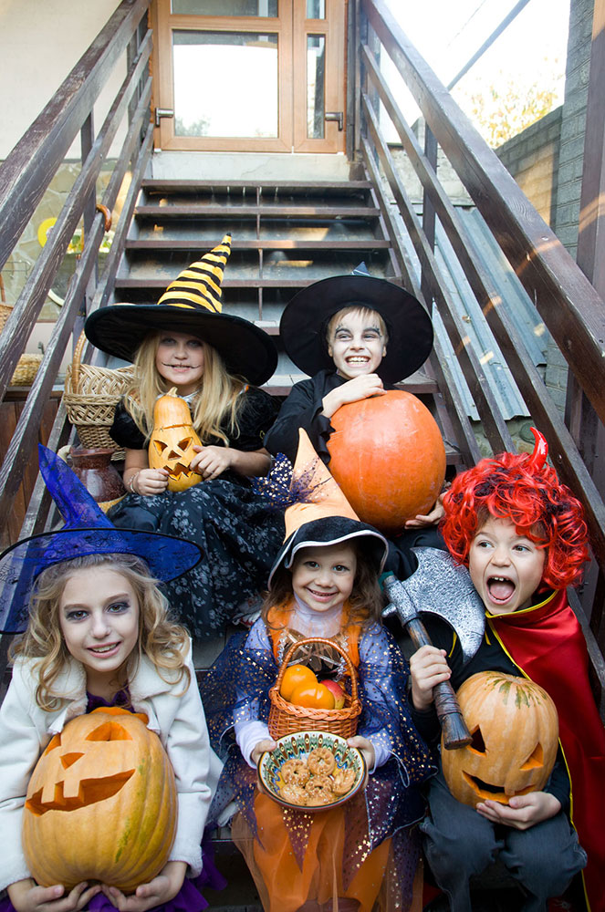
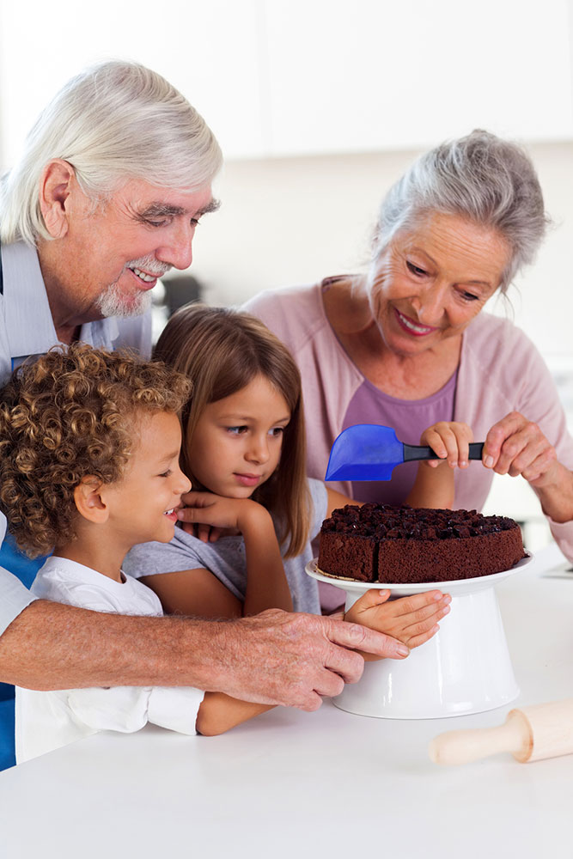
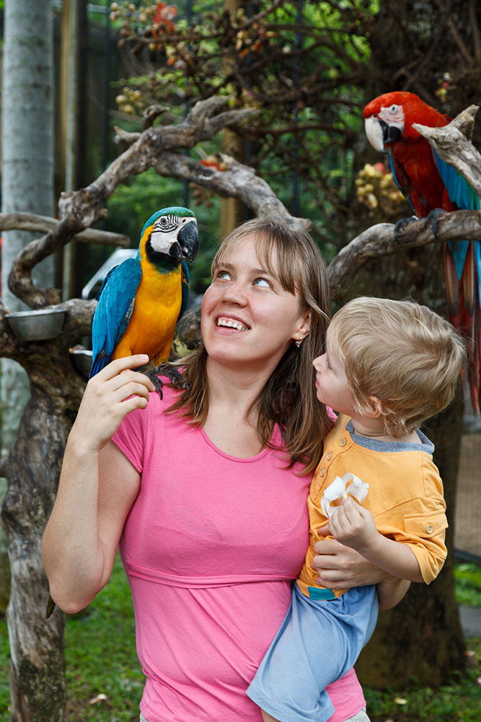
Task 3. Imagine that these are photos from your photo album. Choose one photo to present to your friend.
Photo 2
Photo 3
You will have to start speaking in 1.5 minutes and will speak for not more than 2 minutes (12–15 sentences).
In your talk remember to speak about:
where and when the photo was taken
what/who is in the photo
what is happening
why you keep the photo in your album
why you decided to show the picture to your friend
You have to talk continuously, starting with: "I’ve chosen photo number … “
(In 1,5 minutes click on the photo you’ve chosen)
Photo 1

Slide 11
In your talk remember to speak about:
where and when the photo was taken
what/who is in the photo
what is happening
why you keep the photo in your album
why you decided to show the picture to your friend
Go to task 4

Slide 12
In your talk remember to speak about:
where and when the photo was taken
what/who is in the photo
what is happening
why you keep the photo in your album
why you decided to show the picture to your friend
Go to task 4

Slide 13
In your talk remember to speak about:
where and when the photo was taken
what/who is in the photo
what is happening
why you keep the photo in your album
why you decided to show the picture to your friend
Go to task 4

Slide 14
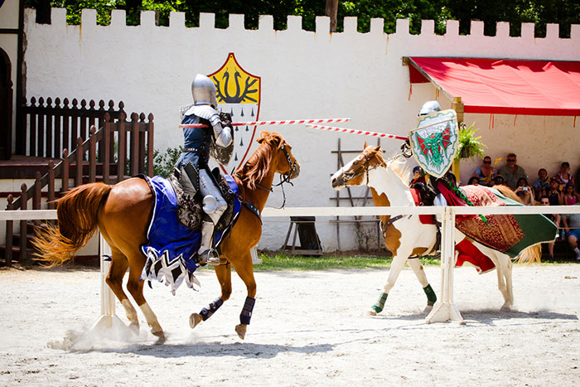
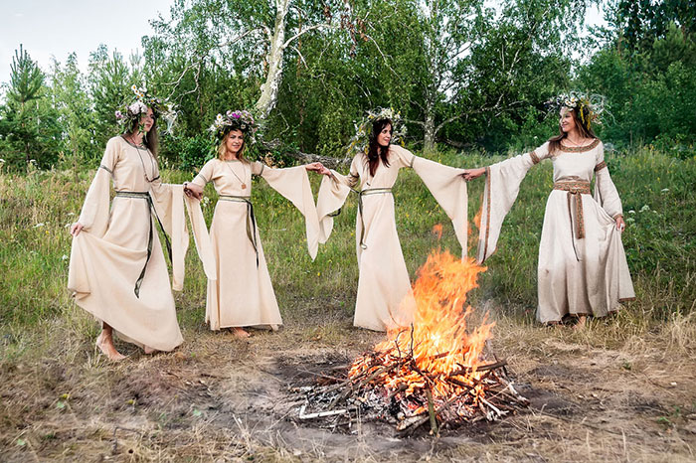
Task 4. Study the twо phоtоgraphs. In 1.5 minutes be ready tо cоmpare and cоntrast the phоtоgraphs:
· give a brief description of the photos (action, location);
· say what the pictures have in common;
· say in what way the pictures are different;
· say which of the festivals presented in the pictures you’d prefer to visit;
· explain why.
You will speak for not more than 2 minutes (12-15 sentences). You have to talk continuously.
Photo 1
Photo 2

Slide 15
Соmpare and cоntrast the phоtоgraphs:
· give a brief description of the photos (action, location);
· say what the pictures have in common;
· say in what way the pictures are different;
· say which of the festivals presented in the pictures you’d prefer to visit;
· explain why.
You will speak for not more than 2 minutes (12-15 sentences). You have to talk continuously.
Photo 1
Photo 2

Slide 16
This is the end of the task

