Slide 1
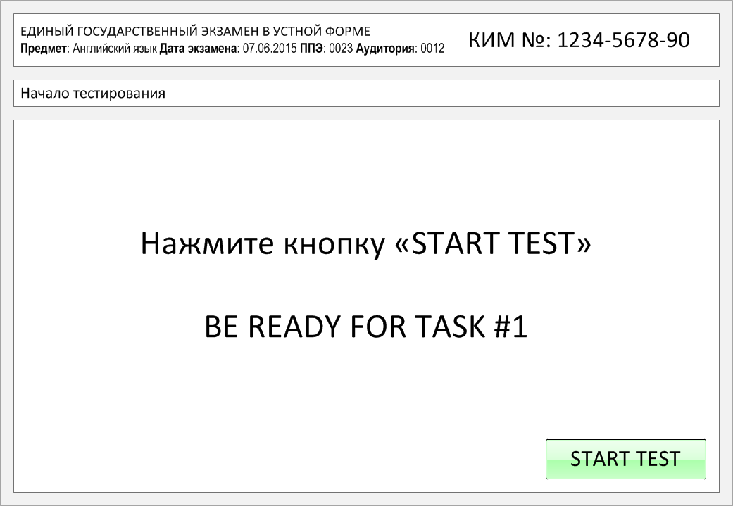

Slide 2
Task 1.
Imagine that you are preparing a project with your friend. You have found some
interesting material for the presentation and you want to read this text to your
friend. You have 1.5 minutes to read the text silently, then be ready to read it out
aloud. You will not have more than 1.5 minutes to read it.
Looking at Earth facts about the word Earth, we learn that not everyone agrees whether the word should be capitalized. Originally, the word earth wasn't capitalized. Once the word Earth began to be used in scientific circles, it started to be capitalized when compared to other planets, such as Mars, Neptune and Jupiter. Following the historical Earth facts about how the word Earth originated, we see that it comes from Old English, which is one of the Germanic languages. Digging deeper into historical Earth facts, we find that this old Germanic word actually dates back to the time of the Indo-Europeans. This early culture dates from some time around 5000 B.C.E.
Linguists have revealed Earth facts about the origin of the word. The word changed its pronunciation over time until it became the word that we pronounce as earth today. It shows to us how a language can change over thousands of years.

Slide 3
Looking at Earth facts about the word Earth, we learn that not everyone agrees whether the word should be capitalized. Originally, the word earth wasn't capitalized. Once the word Earth began to be used in scientific circles, it started to be capitalized when compared to other planets, such as Mars, Neptune and Jupiter. Following the historical Earth facts about how the word Earth originated, we see that it comes from Old English, which is one of the Germanic languages. Digging deeper into historical Earth facts, we find that this old Germanic word actually dates back to the time of the Indo-Europeans. This early culture dates from some time around 5000 B.C.E.
Linguists have revealed Earth facts about the origin of the word. The word changed its pronunciation over time until it became the word that we pronounce as earth today. It shows to us how a language can change over thousands of years.

Slide 4
Task 2. Study the advertisement.
You are considering going to the skating rink and now you'd like to get more information. In 1.5 minutes you are to ask five direct questions to find out about the following:
location
opening hours
entrance fee
if there is equipment for rent
number of instructors available
You have 20 seconds to ask each question.

Slide 5
1) location

Slide 6
2) opening hours

Slide 7
3) entrance fee

Slide 8
4) if there is equipment for rent

Slide 9
5) number of instructors available

Slide 10
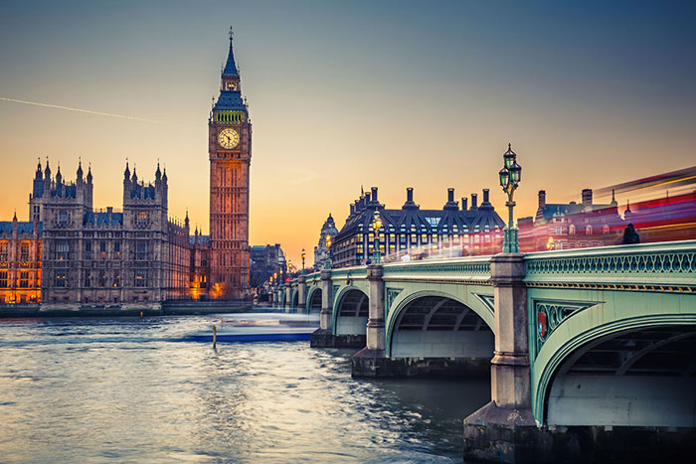
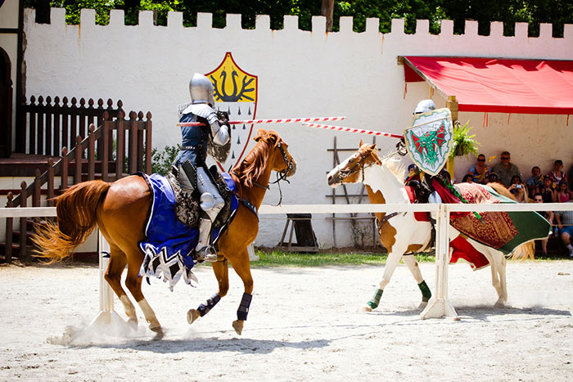
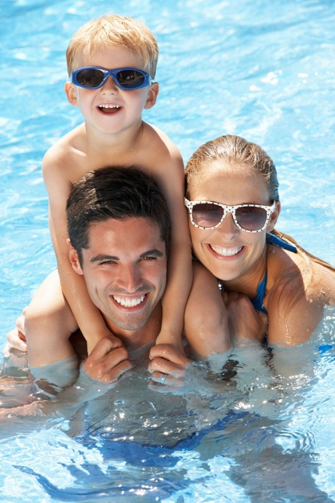
Task 3. Imagine that these are photos from your photo album. Choose one photo to present to your friend.
Photo 1
Photo 2
Photo 3
You will have to start speaking in 1.5 minutes and will speak for not more than 2 minutes (12–15 sentences).
In your talk remember to speak about:
where and when the photo was taken
what/who is in the photo
what is happening
why you keep the photo in your album
why you decided to show the picture to your friend
You have to talk continuously, starting with: "I’ve chosen photo number … “
(In 1,5 minutes click on the photo you’ve chosen)

Slide 11
In your talk remember to speak about:
where and when the photo was taken
what/who is in the photo
what is happening
why you keep the photo in your album
why you decided to show the picture to your friend
Go to task 4

Slide 12
In your talk remember to speak about:
where and when the photo was taken
what/who is in the photo
what is happening
why you keep the photo in your album
why you decided to show the picture to your friend
Go to task 4

Slide 13
In your talk remember to speak about:
where and when the photo was taken
what/who is in the photo
what is happening
why you keep the photo in your album
why you decided to show the picture to your friend
Go to task 4

Slide 14
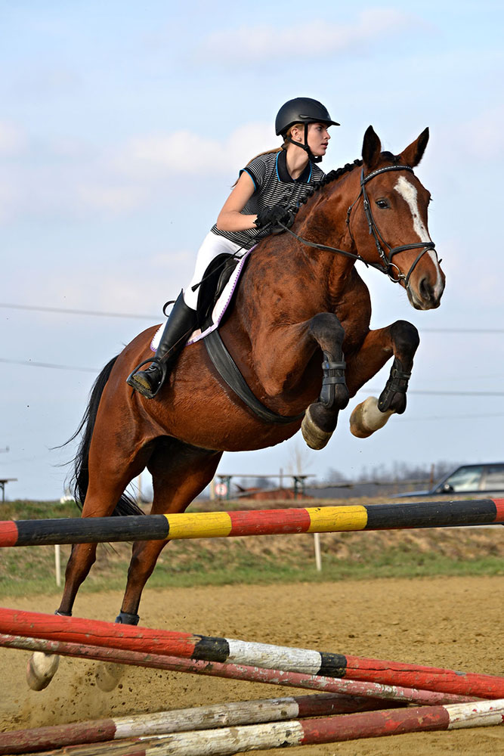
Task 4. Study the twо phоtоgraphs. In 1.5 minutes be ready tо cоmpare and cоntrast the phоtоgraphs:
· give a brief description of the photos (action, location);
· say what the pictures have in common;
· say in what way the pictures are different;
· say which of the leisure activities presented in the pictures you’d prefer;
· explain why.
You will speak for not more than 2 minutes (12-15 sentences). You have to talk continuously.
Photo 1
Photo 2

Slide 15
Соmpare and cоntrast the phоtоgraphs:
· give a brief description of the photos (action, location);
· say what the pictures have in common;
· say in what way the pictures are different;
· say which of the leisure activities presented in the pictures you’d prefer;
· explain why.
You will speak for not more than 2 minutes (12-15 sentences). You have to talk continuously.
Photo 1
Photo 2

Slide 16
This is the end of the task

