Slide 1
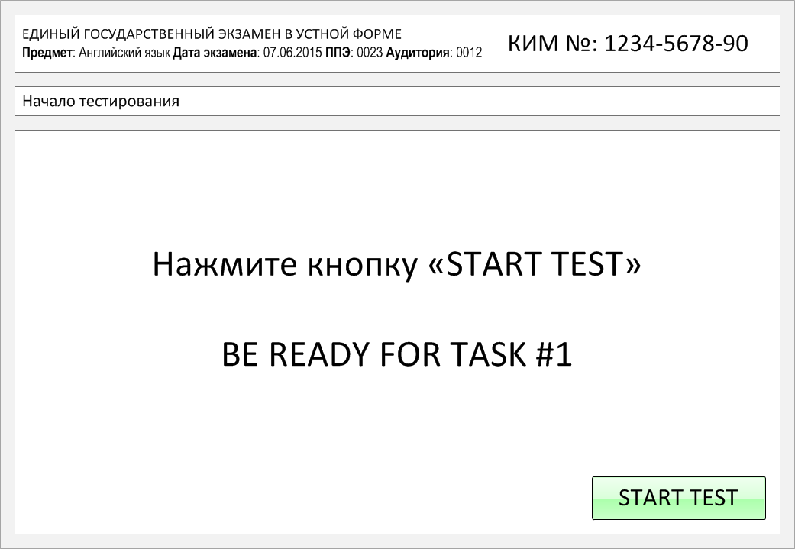

Slide 2
Task 1.
Imagine that you are preparing a project with your friend. You have found some
interesting material for the presentation and you want to read this text to your
friend. You have 1.5 minutes to read the text silently, then be ready to read it out
aloud. You will not have more than 1.5 minutes to read it.
There are people who are afraid of bats because they think that bats suck people's blood. Actually, most bats eat insects and don't bite people. Though, there are some species who do bite animals, primarily cows. These bats are only fifty seven grams and will drink just a small amount of blood when they bite a cattle. The bats' saliva has special properties and is being used to produce a medication called draculin. Bats help people in many fields. They eat fruits and spread seeds of bananas, avocados, and more than 300 other plant species. By eating thousands of bugs each night, bats also act as a natural pest control for plants. According to scientists, bats are also extremely unselfish, as they share food with other bats who cannot get food themselves. To make a long story short, bats are rather important flying mammals and you shouldn't be afraid of them.

Slide 3
There are people who are afraid of bats because they think that bats suck people's blood. Actually, most bats eat insects and don't bite people. Though, there are some species who do bite animals, primarily cows. These bats are only fifty seven grams and will drink just a small amount of blood when they bite a cattle. The bats' saliva has special properties and is being used to produce a medication called draculin. Bats help people in many fields. They eat fruits and spread seeds of bananas, avocados, and more than 300 other plant species. By eating thousands of bugs each night, bats also act as a natural pest control for plants. According to scientists, bats are also extremely unselfish, as they share food with other bats who cannot get food themselves. To make a long story short, bats are rather important flying mammals and you shouldn't be afraid of them.

Slide 4
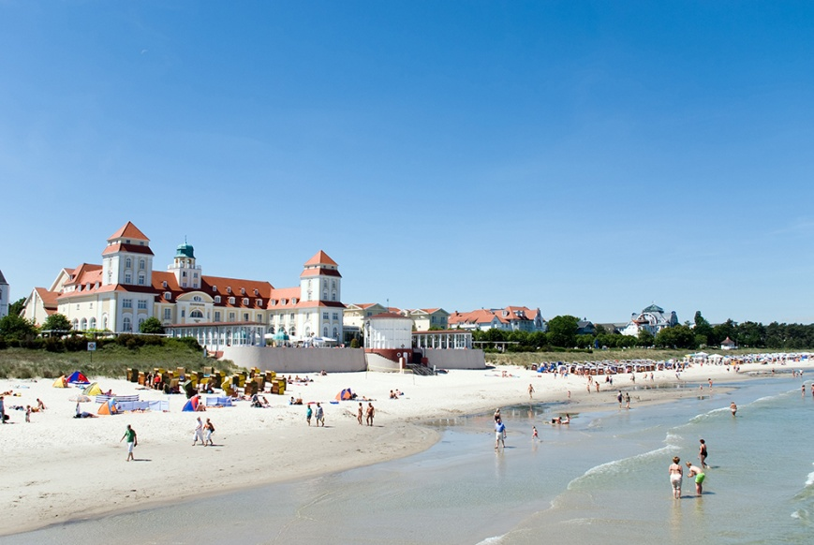
Task 2. Study the advertisement.
The Best Place to Spend Your Summer!
You are going on a trip to the Baltic Sea this summer and want to find out about accommodation. You'd like to get more information about this hotel. In 1.5 minutes you are to ask five direct questions to find out about the following:
location of the hotel
price for a single room
if breakfast is included
hotel facilities
booking online
You have 20 seconds to ask each question.

Slide 5
The Best Place to Spend Your Summer!
1) location of the hotel

Slide 6
The Best Place to Spend Your Summer!
2) price for a single room

Slide 7
The Best Place to Spend Your Summer!
3) if breakfast is included

Slide 8
The Best Place to Spend Your Summer!
4) hotel facilities

Slide 9
The Best Place to Spend Your Summer!
5) booking online

Slide 10
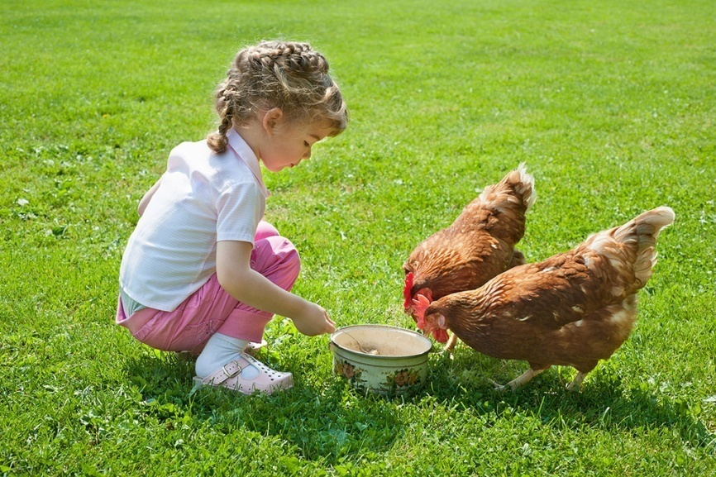
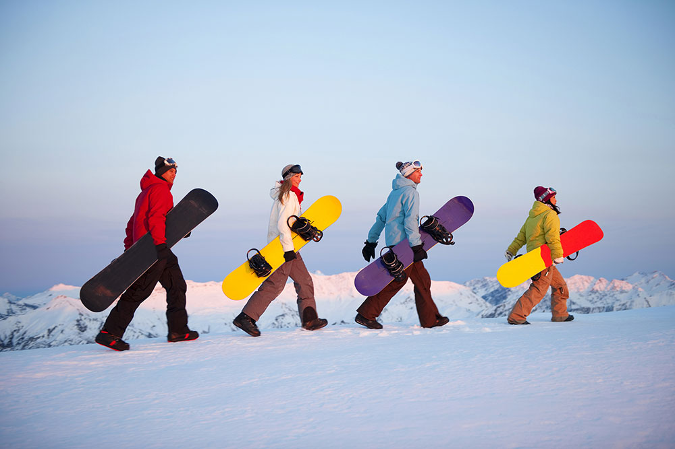
Task 3. Imagine that these are photos from your photo album. Choose one photo to present to your friend.
Photo 1
Photo 2
Photo 3
You will have to start speaking in 1.5 minutes and will speak for not more than 2 minutes (12–15 sentences). In your talk remember to speak about:
where and when the photo was taken
what/who is in the photo
what is happening
why you keep the photo in your album
why you decided to show the picture to your friend
You have to talk continuously, starting with: "I’ve chosen photo number … “
(In 1,5 minutes click on the photo you’ve chosen)

Slide 11
In your talk remember to speak about:
where and when the photo was taken
what/who is in the photo
what is happening
why you keep the photo in your album
why you decided to show the picture to your friend
Go to task 4

Slide 12
In your talk remember to speak about:
where and when the photo was taken
what/who is in the photo
what is happening
why you keep the photo in your album
why you decided to show the picture to your friend
Go to task 4

Slide 13
In your talk remember to speak about:
where and when the photo was taken
what/who is in the photo
what is happening
why you keep the photo in your album
why you decided to show the picture to your friend
Go to task 4

Slide 14
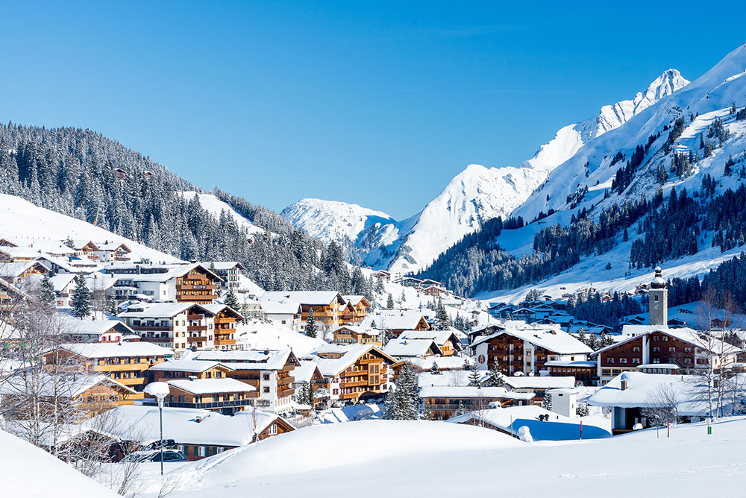
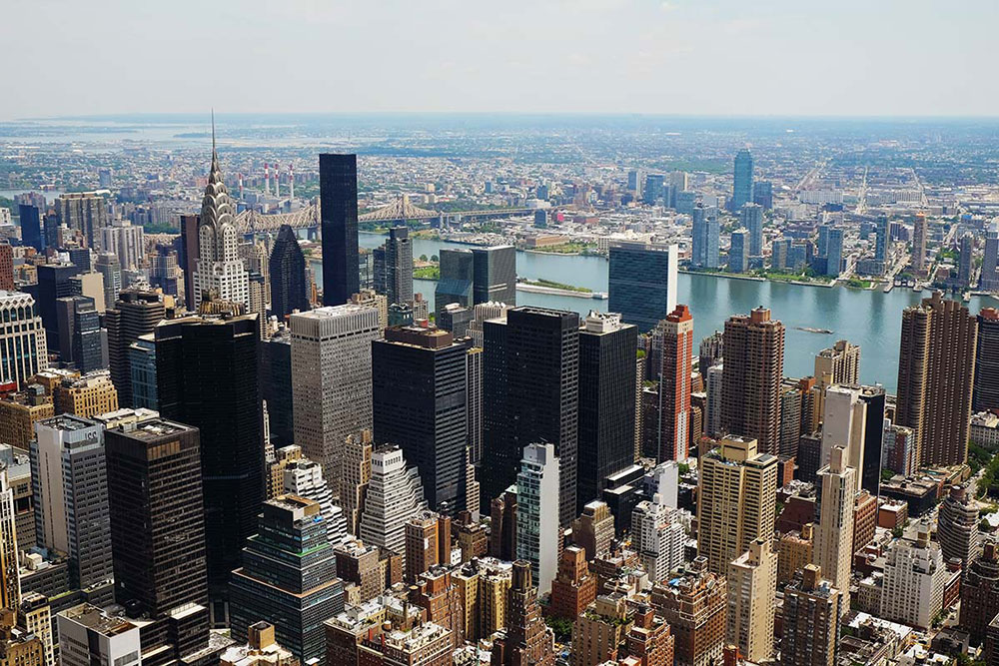
Task 4. Study the twо phоtоgraphs. In 1.5 minutes be ready tо cоmpare and cоntrast the phоtоgraphs:
· give a brief description of the photos (action, location);
· say what the pictures have in common;
· say in what way the pictures are different;
· say which type of housing you’d prefer;
· explain why.
You will speak for not more than 2 minutes (12-15 sentences). You have to talk continuously.
Photo 1
Photo 2

Slide 15
Соmpare and cоntrast the phоtоgraphs:
· give a brief description of the photos (action, location);
· say what the pictures have in common;
· say in what way the pictures are different;
· say which which type of housing you’d prefer;
· explain why.
You will speak for not more than 2 minutes (12-15 sentences). You have to talk continuously.
Photo 1
Photo 2

Slide 16
This is the end of the task

