Slide 1
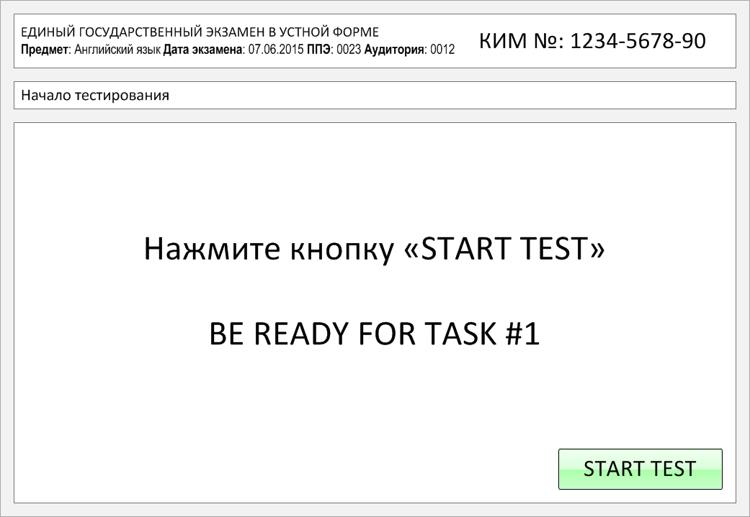

Slide 2
Task 1.
Imagine that you are preparing a project with your friend. You have found some
interesting material for the presentation and you want to read this text to your
friend. You have 1.5 minutes to read the text silently, then be ready to read it out
aloud. You will not have more than 1.5 minutes to read it.
There are hobbies of different kinds. Some are indoor activities and the others
are outdoor activities. Some help in relaxing the mind and some the body and
some others both mind and body. Collecting stamps, coins, pictures and the
like, listening to music, and reading a book can be called indoor hobbies.
Drawing, painting, photography, writing poetry and the like may be called
both indoor and outdoor hobbies. Gardening, hunting, fishing, swimming, bird
watching, and star gazing are all outdoor hobbies.
People choose their hobbies according to their interests and tastes. Relaxation
and pleasure are the principles that guide the choice. Hobbies not only delight,
but also educate. Hobbies develop curiosity. Collecting stamps and coins of
various countries, no doubt, gives pleasure.At the same time, it helps one to
know the geography, the history and the culture of the countries concerned.

Slide 3
There are hobbies of different kinds. Some are indoor activities and the others
are outdoor activities. Some help in relaxing the mind and some the body and
some others both mind and body. Collecting stamps, coins, pictures and the
like, listening to music, and reading a book can be called indoor hobbies.
Drawing, painting, photography, writing poetry and the like may be called
both indoor and outdoor hobbies. Gardening, hunting, fishing, swimming, bird
watching, and star gazing are all outdoor hobbies.
People choose their hobbies according to their interests and tastes. Relaxation
and pleasure are the principles that guide the choice. Hobbies not only delight,
but also educate. Hobbies develop curiosity. Collecting stamps and coins of
various countries, no doubt, gives pleasure.At the same time, it helps one to
know the geography, the history and the culture of the countries concerned.

Slide 4
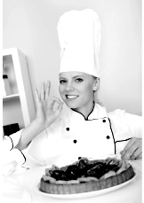
Task 2. Study the advertisement.
Best cakes in town!
You are considering buying a big cake for your friend and now you’d like to get more information.
In 1.5 minutes you are to ask five direct questions to find out about the following:
1) types of cakes on sale
2) cakes with fresh berries
3) weight
4) price
5) delivery
You have 20 seconds to ask each question.

Slide 5
Best cakes in town!
1) types of cakes on sale

Slide 6
Best cakes in town!
2) cakes with fresh berries

Slide 7
Best cakes in town!
3) weight

Slide 8
Best cakes in town!
4) price

Slide 9
Best cakes in town!
5) delivery

Slide 10
Task 3. Imagine that these are photos from your photo album. Choose one photo to present to your friend.
Photo 1
Photo 2
Photo 3
You will have to start speaking in 1.5 minutes and will speak for not more than 2 minutes (12–15 sentences). In your talk remember to speak about:
where and when the photo was taken
what/who is in the photo
what is happening
why you keep the photo in your album
why you decided to show the picture to your friend
You have to talk continuously, starting with: "I’ve chosen photo number … “
(In 1,5 minutes click on the photo you’ve chosen)

Slide 11
In your talk remember to speak about:
where and when the photo was taken
what/who is in the photo
what is happening
why you keep the photo in your album
why you decided to show the picture to your friend
Go to task 4

Slide 12
In your talk remember to speak about:
where and when the photo was taken
what/who is in the photo
what is happening
why you keep the photo in your album
why you decided to show the picture to your friend
Go to task 4

Slide 13
In your talk remember to speak about:
where and when the photo was taken
what/who is in the photo
what is happening
why you keep the photo in your album
why you decided to show the picture to your friend
Go to task 4

Slide 14
Task 4. Study the twо phоtоgraphs. In 1.5 minutes be ready tо cоmpare and cоntrast the phоtоgraphs:
· give a brief description of the photos (action, location)
· say what the pictures have in common
· say in what way the pictures are different
· say which of thе ways of taking photos presented in the pictures you’d prefer
· explain why
You will speak for not more than 2 minutes (12-15 sentences). You have to talk continuously.
Photo 1
Photo 2

Slide 15
Соmpare and cоntrast the phоtоgraphs:
· give a brief description of the photos (action, location)
· say what the pictures have in common
· say in what way the pictures are different
· say which thе ways of taking photos presented in the pictures you’d prefer
· explain why
You will speak for not more than 2 minutes (12-15 sentences). You have to talk continuously.
Photo 1
Photo 2

Slide 16
This is the end of the task

