Slide 1
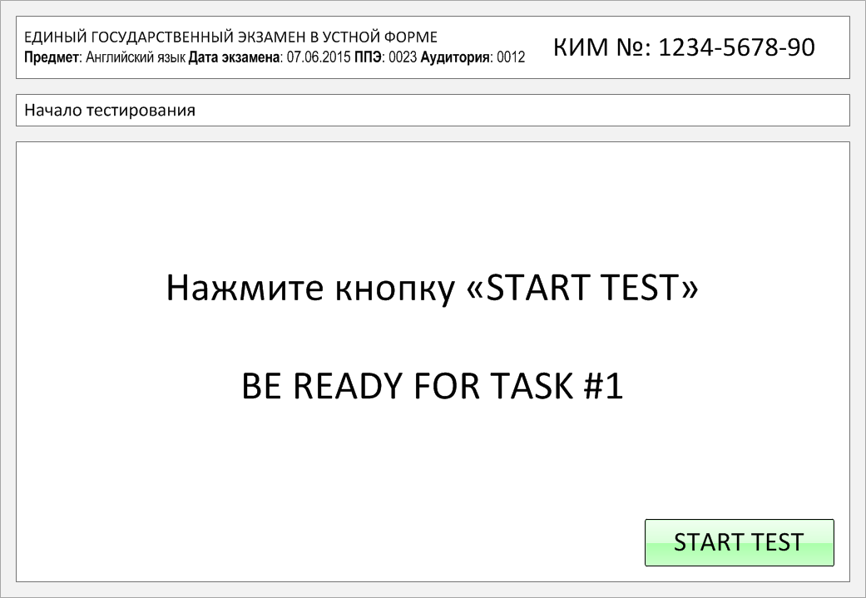

Slide 2
Task 1.
Imagine that you are preparing a project with your friend. You have found some
interesting material for the presentation and you want to read this text to your
friend. You have 1.5 minutes to read the text silently, then be ready to read it out
aloud. You will not have more than 1.5 minutes to read it.
Celebrating New Year’s Eve is a universal tradition, but countries see the New Year
in with different customs. You are probably familiar with the New Year’s Eve
traditions of your own country, but do you know what the holiday looks like
elsewhere around the globe? While many countries have fireworks, some also
have their own unique traditions and customs. Here's a taste of some of the ways
different countries usher in the New Year. Spanish New Year’s Eve usually
starts with a traditional family dinner, but perhaps the most notable tradition is
the countdown to midnight. Just before the clock strikes midnight, 12 grapes
should be eaten as quickly as possible. In Russia a popular tradition is to bid
farewell to the last year and welcome in the new one. Shortly before midnight,
many Russians tune in to watch the president’s speech on TV or watch popular New Year shows.

Slide 3
Celebrating New Year’s Eve is a universal tradition, but countries see the New Year
in with different customs. You are probably familiar with the New Year’s Eve
traditions of your own country, but do you know what the holiday looks like
elsewhere around the globe? While many countries have fireworks, some also
have their own unique traditions and customs. Here's a taste of some of the ways
different countries usher in the New Year. Spanish New Year’s Eve usually
starts with a traditional family dinner, but perhaps the most notable tradition is
the countdown to midnight. Just before the clock strikes midnight, 12 grapes
should be eaten as quickly as possible. In Russia a popular tradition is to bid
farewell to the last year and welcome in the new one. Shortly before midnight,
many Russians tune in to watch the president’s speech on TV or watch popular New Year shows.

Slide 4
Task 2. Study the advertisement.
The journey of your life from our Travel Agency!
You are considering going to the mountains and now you’d like to get more information. In 1.5 minutes you are to ask five direct questions to find out about the following:
1) departure dates
2) duration of the trip
3) size of the group
4) accommodation
5) price
You have 20 seconds to ask each question.

Slide 5
1) departure dates

Slide 6
2) duration of the trip

Slide 7
3) size of the group

Slide 8
4) accommodation

Slide 9
5) price

Slide 10
Task 3. Imagine that these are photos from your photo album. Choose one photo to present to your friend.
You will have to start speaking in 1.5 minutes and will speak for not more
than 2 minutes (12–15 sentences). In your talk remember to speak about:
where and when the photo was taken
what/who is in the photo
what is happening
why you keep the photo in your album
why you decided to show the picture to your friend
You have to talk continuously, starting with:
"I’ve chosen photo number … "

Slide 11
In your talk remember to speak about:
where and when the photo was taken
what/who is in the photo
what is happening
why you keep the photo in your album
why you decided to show the picture to your friend
Go to task 4

Slide 12
In your talk remember to speak about:
where and when the photo was taken
what/who is in the photo
what is happening
why you keep the photo in your album
why you decided to show the picture to your friend
Go to task 4

Slide 13
In your talk remember to speak about:
where and when the photo was taken
what/who is in the photo
what is happening
why you keep the photo in your album
why you decided to show the picture to your friend
Go to task 4

Slide 14

Task 4. Study the twо phоtоgraphs. In 1.5 minutes be ready tо cоmpare and cоntrast the phоtоgraphs:
· give a brief description of the photos (action, location)
· say what the pictures have in common
· say in what way the pictures are different
· say which of thе profеssions presented in the pictures you’d prefer
· explain why
You will speak for not more than 2 minutes (12-15 sentences). You have to
talk continuously.

Slide 15
Соmpare and cоntrast the phоtоgraphs:
· give a brief description of the photos (action, location)
· say what the pictures have in common
· say in what way the pictures are different
· say which thе profеssions presented in the pictures you’d prefer
· explain why
You will speak for not more than 2 minutes (12-15 sentences). You have to
talk continuously.

Slide 16
This is the end of the task

