Slide 1
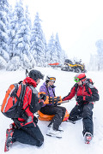
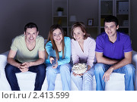
Задание 4
Study the two photographs. In 1.5 minutes be ready to compare and contrast the photographs:
give a brief description of the photos (action, location)
say what the pictures have in common
say in what way the pictures are different
say which of the leisure activities presented in the pictures you’d prefer
explain why

Slide 2
Задание 4
Everybody spends free time differently. Here are two photos that are connected with leisure activities.
In the first picture we can see three young people doing some winter sport. There are huge pine trees covered with snow in the background of the picture. The people are having rest . They are definitely enjoying themselves. In the second picture there is a family watching a film at home. They are sitting on the sofa looking at the screen and having some popcorn as if they were at the cinema.
The pictures have a lot in common though they may seem different. First of all, the people in the pictures are not at work. It’s their leisure time. Both groups of people are having fun and are pleased with what they are doing .

Slide 3
But still the pictures are not quite alike. The people in the first picture are staying in the open. The family in the second picture are indoors. The main difference is that the first group of people prefers sport activities while the others like to spend their free time quietly at home.
As for me I surely prefer skiing and skating in the open .I am fond of healthy life style in general and winter sports in particular that’s why I’d prefer the activities in picture 1.
I reckon most of my friends will agree to me as the majority of young people are keen on sports. That’s all to it.

